Slide 1
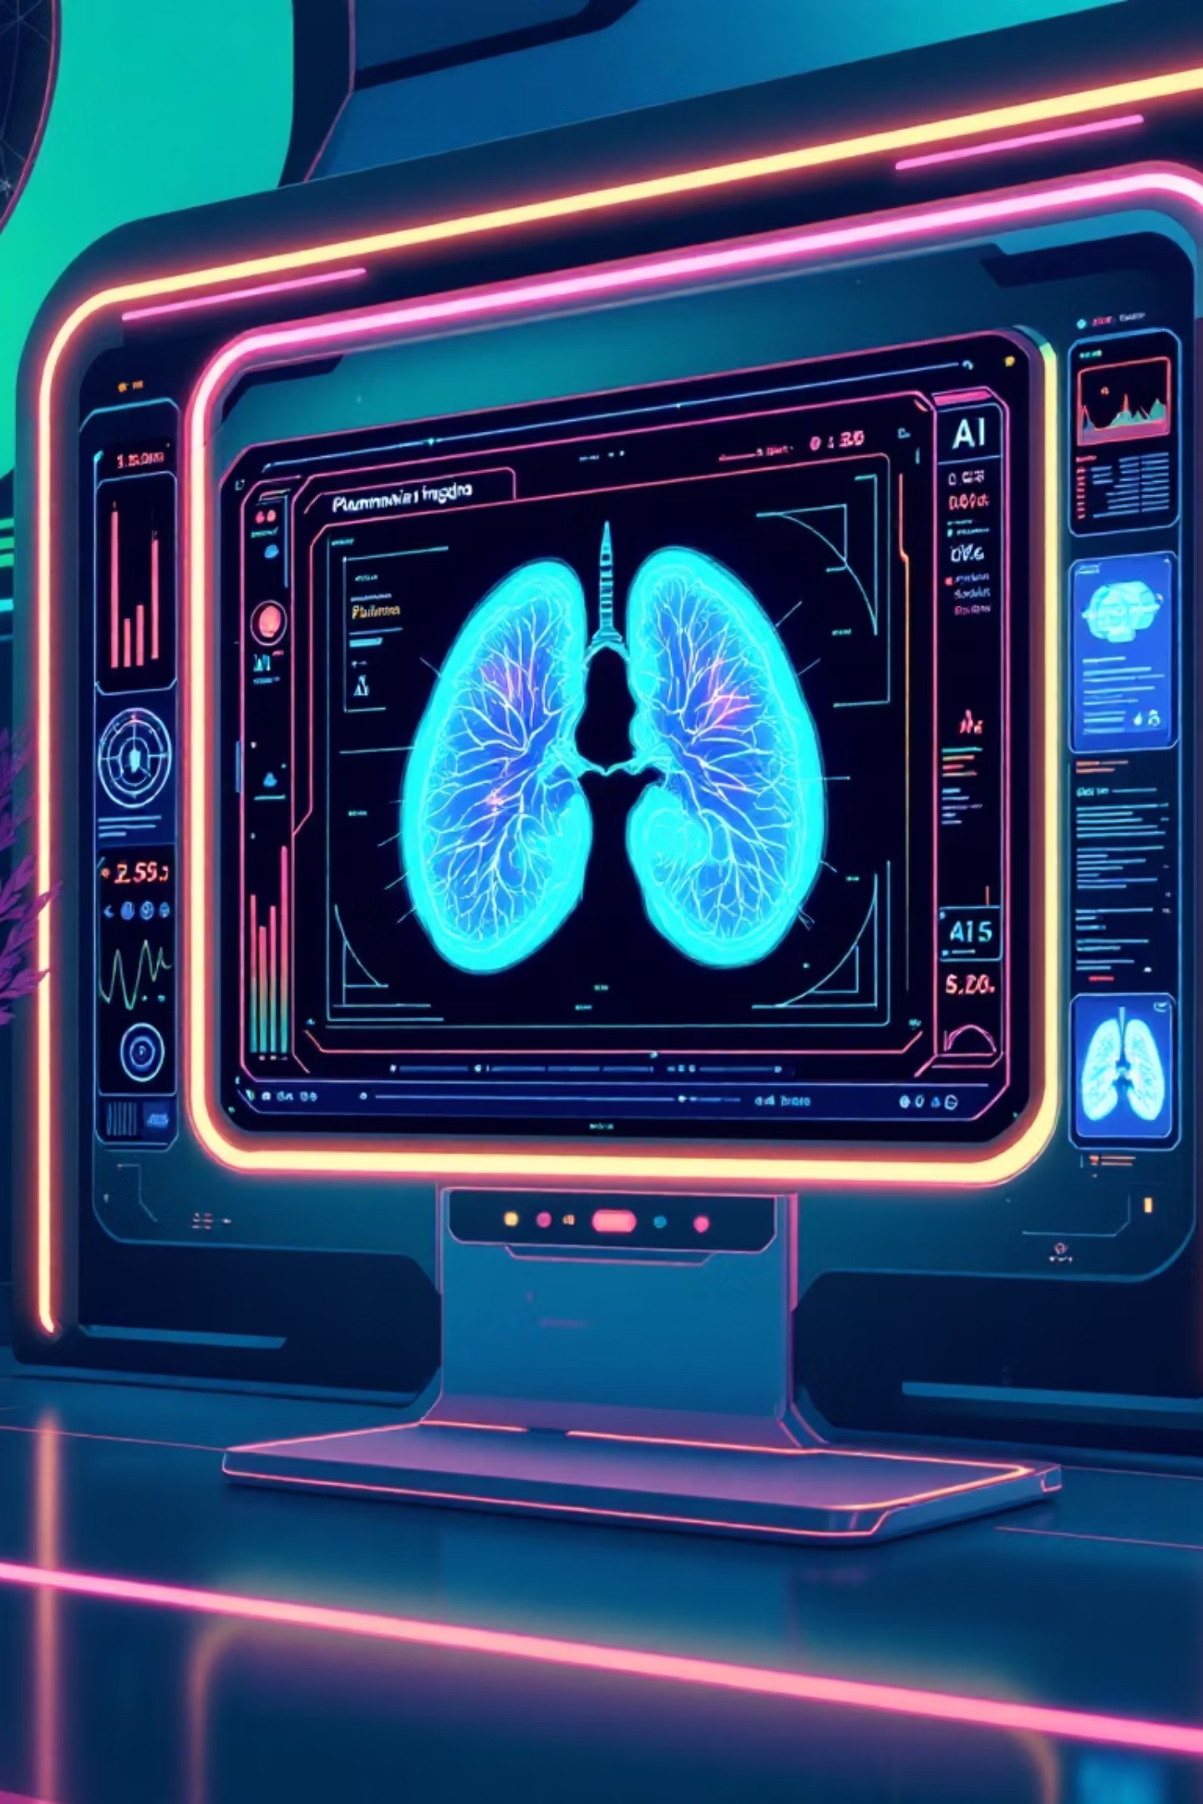
An Explainable Deep Learning Framework for Pneumonia Diagnosis Using GRAD-CAM and ConvNeXt
Presented by Team Velocity: Akshay L N Shet, Sujeet Yadav, Nandini A, and Shreya J H.
Our team introduces an advanced framework designed to enhance the accuracy and transparency of pneumonia diagnosis from chest X-ray images. Leveraging the power of explainable AI, our solution aims to provide clinical researchers and AI engineers with reliable and interpretable diagnostic tools.

Slide 2
Abstract
Diagnosing pneumonia from chest X-rays presents significant challenges due to inherent image complexities such as noise, low contrast, and the subtle, varied patterns of infection. These factors often lead to diagnostic ambiguity and potential for missed cases.
Explainable AI Framework
ConvNeXt-based Classification
We propose an explainable AI framework that significantly enhances X-ray image quality. This is achieved through a diffusion-inspired denoising process, which effectively mitigates noise and improves contrast, making subtle infection patterns more discernible.
Following denoising, the improved X-ray images are processed by a ConvNeXt-based deep learning model for classification. ConvNeXt, known for its strong performance in computer vision tasks, accurately differentiates between normal and pneumonia cases.
Grad-CAM for Transparency
Clinical Impact
To ensure transparency and interpretability, we integrate Grad-CAM (Gradient-weighted Class Activation Mapping). Grad-CAM generates visual heatmaps that highlight the specific lung regions the ConvNeXt model considers most influential in its predictions, providing critical context for clinical review.
Our comprehensive approach not only improves the reliability of diagnostic predictions but also aims to reduce the incidence of missed pneumonia cases. The interpretable results, facilitated by Grad-CAM, make this framework highly suitable for real-world clinical decision support, fostering greater trust in AI-driven medical diagnostics.

Slide 3

Pipeline Diagram
Our diagnostic framework follows a clear, sequential pipeline, ensuring both accurate prediction and transparent interpretability. The process begins with raw X-ray data, progresses through sophisticated deep learning classification, and concludes with explainable visualizations to assist clinicians.
ConvNeXt Prediction
Deep learning classification
Evaluation & Grad-CAM
X-ray Input
Acquire and preprocess images
Assess results and visualize explanations
X-ray Input: Initial chest X-ray images are fed into the system after initial preprocessing steps.
ConvNeXt Prediction: The advanced ConvNeXt model processes the images to classify them as either 'normal' or 'pneumonia'. This deep learning component is the core of our diagnostic accuracy.
Evaluation: The model's predictions undergo rigorous evaluation against ground truth data to ensure high performance and reliability.
Grad-CAM Output: Post-prediction, Grad-CAM generates visual heatmaps over the original X-ray. These heatmaps highlight the precise regions of the lung that most strongly influenced the ConvNeXt model's classification, providing crucial insights into the model's decision-making process. This feature is particularly vital for clinical validation and building trust in AI diagnostics.

Slide 4
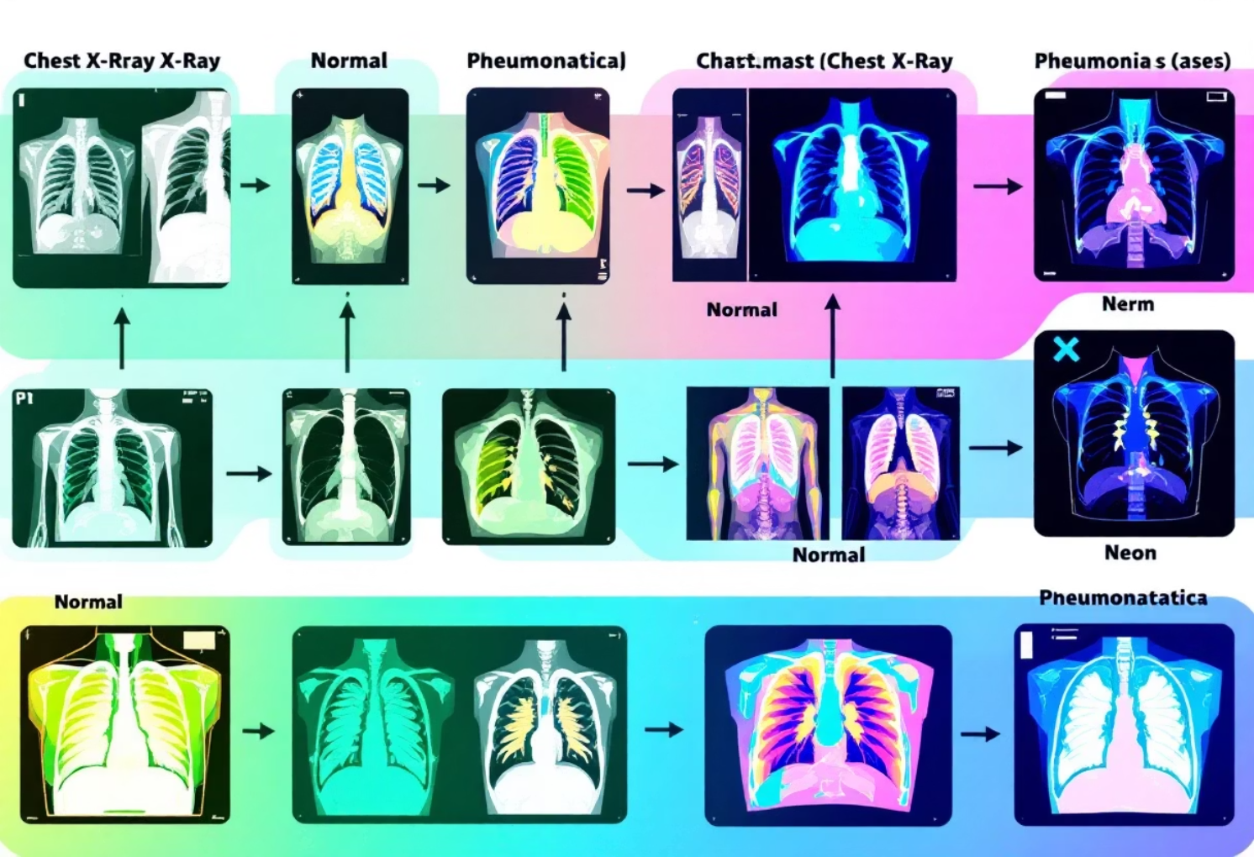
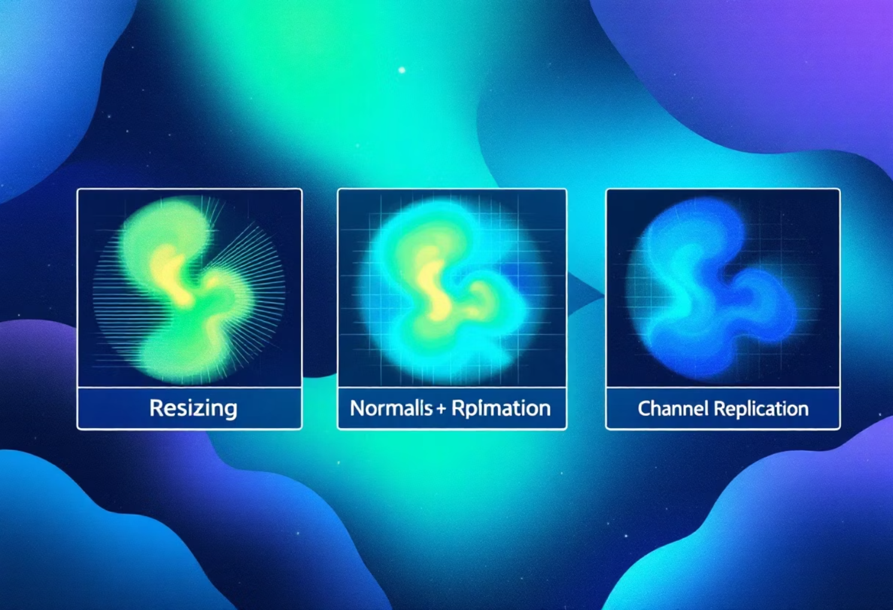
Methodology: Data Set and Preprocessing
Data Set
For this study, we utilized a publicly available Chest X-ray dataset, which is meticulously curated to facilitate research in medical imaging. This dataset is critical for training robust deep learning models for pneumonia detection.
Categories: The dataset comprises two distinct categories: normal chest X-rays and those exhibiting signs of pneumonia. This binary classification allows for focused model training.
Image Characteristics: All images are frontal-view chest X-rays, a standard projection in clinical practice. They were acquired under varied imaging conditions, which is a crucial aspect. This variability, including differences in exposure, patient positioning, and equipment, accurately reflects the challenges and diversity encountered in real-world clinical environments. By training on such a diverse dataset, our model gains improved generalization capabilities.
The dataset's realistic nature ensures that the developed AI framework is more likely to perform effectively when deployed in actual clinical settings, handling the inherent noise and inconsistencies of diagnostic images.
Data Preprocessing
Effective data preprocessing is paramount to ensure that the input to the deep learning model is optimized for performance and consistency. Our preprocessing pipeline involved several critical steps:
Image Resizing: All X-ray images were uniformly resized to 224 × 224 pixels. This standardized resolution is a common requirement for many convolutional neural networks, ensuring consistent input dimensions and computational efficiency.
Intensity Normalization: To mitigate variations in image brightness and contrast across different scans, intensity normalization was applied. Images were normalized using a mean of 0.5 and a standard deviation of 0.5. This process centers the pixel values and scales them to a uniform range, which can significantly improve model convergence and performance.
Grayscale to RGB Replication: Many chest X-rays are originally grayscale (single channel). However, most advanced deep learning architectures, including ConvNeXt, are pre-trained on RGB (three-channel) datasets like ImageNet. To match these input requirements, grayscale images were replicated to 3 channels. This ensures compatibility without introducing new information, allowing the model to leverage its pre-trained weights effectively.
These preprocessing steps are crucial for preparing a clean, consistent, and compatible dataset for deep learning analysis, thereby enhancing the accuracy and reliability of our pneumonia diagnosis framework.

Slide 5

Model Architecture
Our framework integrates two powerful AI components: ConvNeXt for robust image classification and Grad-CAM for vital explainability.
ConvNeXt
Grad-CAM (Explainability AI)
ConvNeXt represents a modern convolutional neural network architecture, redesigning traditional CNNs to compete with the performance of Vision Transformers. Its key characteristics make it ideal for complex medical image analysis:
Gradient-weighted Class Activation Mapping (Grad-CAM) is a pivotal technique in our framework, providing crucial transparency to the deep learning model's decisions. It addresses the "black box" nature of CNNs:
Heatmap Generation: Grad-CAM generates heatmaps that visually indicate which specific regions of an input image a Convolutional Neural Network (CNN)-based model focused on to arrive at its prediction. Areas highlighted in red indicate high importance.
Interpretability: This visualization is invaluable for interpreting model decisions. In medical imaging, it allows clinicians to see if the AI is attending to the diagnostically relevant areas of the X-ray, such as consolidations or infiltrates indicative of pneumonia.
Trust and Debugging: By making the model's reasoning transparent, Grad-CAM helps build trust in AI systems. It also serves as a powerful debugging tool, identifying instances where the model might be focusing on spurious features rather than true pathological signs. This is particularly critical in high-stakes applications like medical diagnosis and autonomous driving.
Pretrained on ImageNet: The model benefits from being pretrained on the vast ImageNet dataset. This provides strong feature initialization, allowing it to capture rich, generalizable visual patterns that are then fine-tuned for the specific nuances of chest X-ray images.
Hierarchical Convolutional Blocks: ConvNeXt employs hierarchical convolutional blocks that are adept at learning spatial features across different scales. This is crucial for medical images where pneumonia manifestations can range from localized opacities to diffuse patterns.
Efficient Representation: Its architecture is designed for efficient representation of complex visual attributes such as texture and opacity patterns, which are critical diagnostic indicators in medical imaging.

Slide 6
Model Training: Optimizing for Accuracy and Stability
The successful deployment of our ConvNeXt model for pneumonia diagnosis relies heavily on a meticulously designed training regimen. This involves selecting appropriate loss functions, optimizers, and learning rate strategies to ensure high diagnostic accuracy and model stability.
Loss Function: Cross-Entropy Loss
Optimizer: AdamW
We employed Cross-Entropy Loss as our primary loss function. This choice is standard and highly effective for binary classification tasks, such as distinguishing between 'normal' and 'pneumonia' cases. Cross-entropy loss quantifies the difference between the predicted probability distribution and the true distribution. Its goal is to minimize this difference, effectively guiding the model to make more accurate predictions by penalizing incorrect classifications more heavily.
The AdamW optimizer was selected for its robust performance and efficiency in training deep neural networks. AdamW is an extension of the Adam optimizer that decouples weight decay from the gradient update, leading to better generalization and often faster convergence. This optimization strategy helps in navigating the complex loss landscape of deep models, ensuring that the model converges to an optimal set of weights.
Learning Rate: Low Learning Rate for Fine-tuning
Scheduler: Learning Rate Decay
A low learning rate was strategically chosen for stable fine-tuning. Given that our ConvNeXt model is pre-trained on ImageNet, a low learning rate allows for incremental adjustments to the pre-existing, highly effective weights. This prevents large, disruptive updates that could destabilize the training process and potentially lead to overfitting or divergence from optimal performance, especially when adapting to a new domain like medical imaging.
To further enhance training stability and prevent overfitting, a learning rate decay scheduler was implemented. This scheduler gradually reduces the learning rate over time as training progresses. This approach helps the model make finer adjustments in later epochs, allowing it to settle into a more precise minimum of the loss function. It is a critical technique to avoid oscillations around the optimum and ensure the model's generalization ability to unseen data.

Slide 7
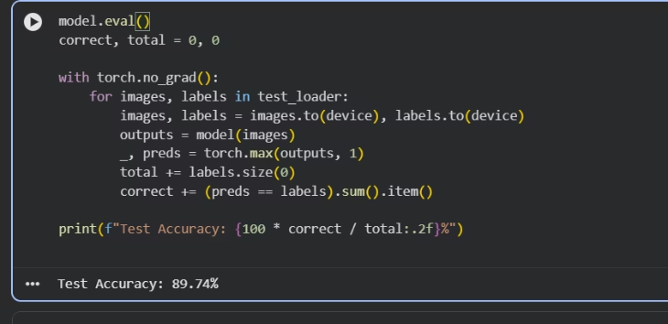
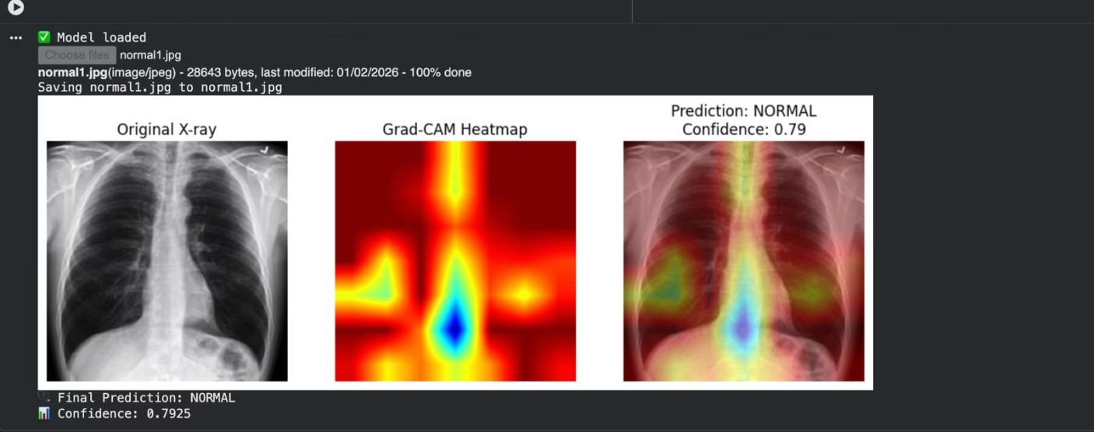
Results: Performance Metrics and Visual Explanations
Our model demonstrates strong performance in pneumonia classification, as evidenced by key metrics. Furthermore, Grad-CAM visualizations provide critical insights into the model's decision-making process, showcasing its ability to localize pathological regions.
Grad-CAM Visualization
The Grad-CAM heatmaps are instrumental in providing transparency to our deep learning model. These visualizations overlay the X-ray images, highlighting the regions that most strongly influenced the model's classification decision.
Confusion Matrix Analysis
Localization of Pathology: As depicted in the image, the vibrant regions in the heatmap correspond to the areas of the lung that the ConvNeXt model deemed most relevant for its pneumonia prediction. These often align with visible consolidations or infiltrates.
Interpretability for Clinicians: This visual feedback allows clinicians to rapidly assess if the AI's "reasoning" aligns with medical knowledge, enhancing trust and providing a second opinion that is explainable rather than a black box.
Debugging and Validation: The heatmaps are also crucial for model developers to debug potential biases or errors, ensuring the model is learning from the correct features of the image.
The confusion matrix provides a detailed breakdown of our model's classification performance. It visualizes the number of correct and incorrect predictions made by the model compared to the actual outcomes.
From the matrix, we can observe:
True Positives (TP): The number of pneumonia cases correctly identified.
True Negatives (TN): The number of normal cases correctly identified.
False Positives (FP): Cases where the model incorrectly predicted pneumonia (Type I error).
False Negatives (FN): Cases where the model failed to detect pneumonia (Type II error), which are particularly critical in medical diagnosis.
A high number of TPs and TNs, coupled with low FPs and FNs, indicates a robust and reliable diagnostic system, essential for clinical applications.
Together, the quantitative performance metrics and qualitative Grad-CAM visualizations confirm the efficacy and interpretability of our framework for pneumonia diagnosis.

Slide 8
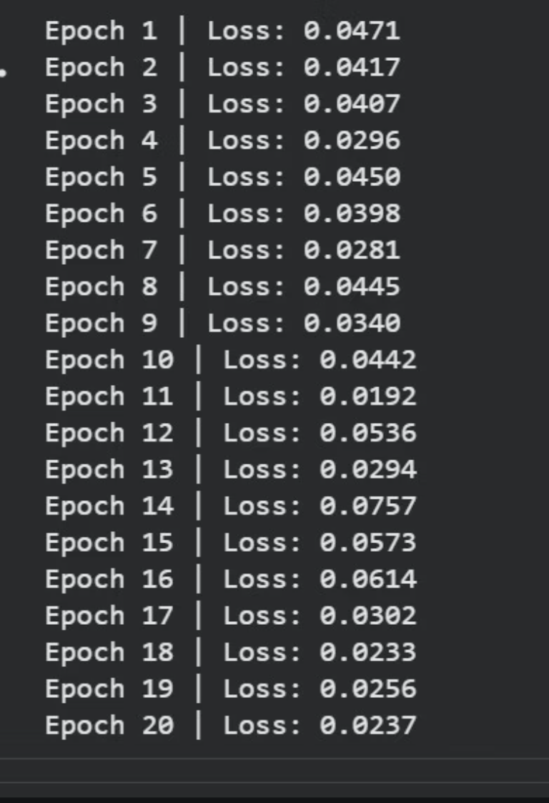
Future Work: Expanding the Horizon of AI in Medical Imaging
Our current framework lays a strong foundation for explainable AI in pneumonia diagnosis. However, the field of medical imaging and deep learning is constantly evolving, presenting numerous avenues for future research and enhancements.
Longitudinal Studies and Prognostic Capabilities
Applying our framework to longitudinal datasets (sequential X-rays of the same patient over time) could enable the model to track disease progression or regression. This would open doors for developing prognostic capabilities, allowing clinicians to predict patient outcomes, response to treatment, or potential complications based on imaging biomarkers extracted by the AI.
Enhanced Explainability Techniques
While Grad-CAM provides excellent spatial localization, exploring other advanced explainability techniques (e.g., LIME, SHAP, attention-based mechanisms) could offer deeper insights into the model's reasoning. Developing human-understandable explanations that directly link AI features to known pathological patterns would further bridge the gap between AI predictions and clinical decision-making.
Real-world Clinical Validation
Ultimately, extensive real-world clinical validation through prospective studies is crucial. Collaborating with medical institutions to test the framework in diverse clinical settings and with larger, more varied patient populations will be essential to confirm its robustness, generalizability, and clinical utility.
Multi-class Classification and Severity Assessment
Currently, our model focuses on binary classification (normal vs. pneumonia). A significant future direction involves expanding its capabilities to multi-class classification, differentiating between various types of pneumonia (e.g., bacterial, viral, fungal) and other lung pathologies that may present similarly. Furthermore, integrating severity assessment would be highly beneficial, allowing the model to quantify the extent of lung involvement and disease progression, which is crucial for treatment planning and prognosis.
Integration of Clinical Metadata
The diagnostic accuracy of AI models can be further enhanced by incorporating clinical metadata alongside image data. This includes patient demographics (age, sex), clinical symptoms, laboratory results, and medical history. Fusing these diverse data modalities could provide a more holistic view, improve diagnostic precision, and help in differentiating between conditions that appear similar on imaging but have distinct clinical presentations.

Slide 9
Broader Impact and Ethical Considerations
The development of explainable deep learning frameworks for medical diagnosis carries profound implications beyond technical performance. It touches upon patient care, clinical workflows, and ethical responsibilities.
1
2
Improved Patient Outcomes
Enhanced Clinical Efficiency
By reducing diagnostic errors and accelerating detection, our framework can lead to earlier intervention and more effective treatment plans, directly improving patient recovery rates and reducing morbidity.
The AI acts as an intelligent assistant, streamlining the review process for radiologists and clinicians. This can free up valuable time, allowing medical professionals to focus on complex cases and direct patient care.
3
4
Addressing Healthcare Disparities
Building Trust in AI
Deploying accessible AI diagnostic tools, particularly in underserved regions with limited access to specialist radiologists, can help level the playing field and improve diagnostic consistency globally.
The explainable nature of Grad-CAM is critical for fostering trust among clinicians and patients. Understanding why an AI makes a particular recommendation is essential for its adoption in high-stakes medical settings.
5
6
Ethical Deployment
Continuous Learning and Oversight
Careful consideration of ethical implications is paramount. This includes addressing data privacy, algorithmic bias (ensuring fairness across diverse patient populations), and the clear delineation of responsibility between AI tools and human medical professionals.
The framework should facilitate continuous learning from new data while maintaining human oversight. Regular auditing of AI performance and explanations is necessary to ensure it remains reliable and unbiased over time.

Slide 10



Conclusion: Towards a Future of Transparent and Reliable AI Diagnostics
Our proposed explainable deep learning framework for pneumonia diagnosis, integrating ConvNeXt with Grad-CAM, represents a significant step forward in the application of artificial intelligence in medical imaging. We have demonstrated a robust pipeline that not only achieves high diagnostic accuracy but also provides crucial transparency, a feature often lacking in complex AI models.
Enhanced Diagnosis
Interpretable Results
Clinical Decision Support
The use of diffusion-inspired denoising and ConvNeXt-based classification improves the reliability of pneumonia detection from challenging chest X-rays.
Grad-CAM heatmaps offer explainable insights, allowing clinicians to understand the model's reasoning and localize areas of interest on the X-ray images.
This framework is designed to seamlessly integrate into clinical workflows, offering invaluable support for medical professionals in making more informed and confident diagnostic decisions.
By prioritizing both performance and interpretability, we aim to foster greater trust in AI-driven diagnostic tools. This framework serves as a foundation for future advancements, paving the way for more intelligent, transparent, and ultimately, more beneficial AI applications in healthcare. We believe that the fusion of cutting-edge deep learning with explainability will empower clinicians and lead to improved patient care worldwide.

